Slide 1
Modeling of Plant Disease
Julia Nelson

Slide 2
Outline
History of Modeling Plant Disease
Types of Plant Diseases
Disease Forecasting Systems
Modeling Factors
Modeling Factors cont.
Disease Progress Curves
Monocyclic vs Polycyclic
Computer Simulations
Importance of Plant Disease Modeling
Sources

Slide 3
History of Modeling Plant Disease
“A plant disease model is a simplification of the relationships (between a pathogen, a host plant, and the environment) that determine whether and how an epidemic develops over time and space.”
Major Plant Disease Epidemics pushed for need for better understanding of disease
Irish Potato Famine (1845-1849)
Models used for plant disease management to protect crop growth
https://doi.org/10.1007/978-90-481-9277-9_15

Slide 4
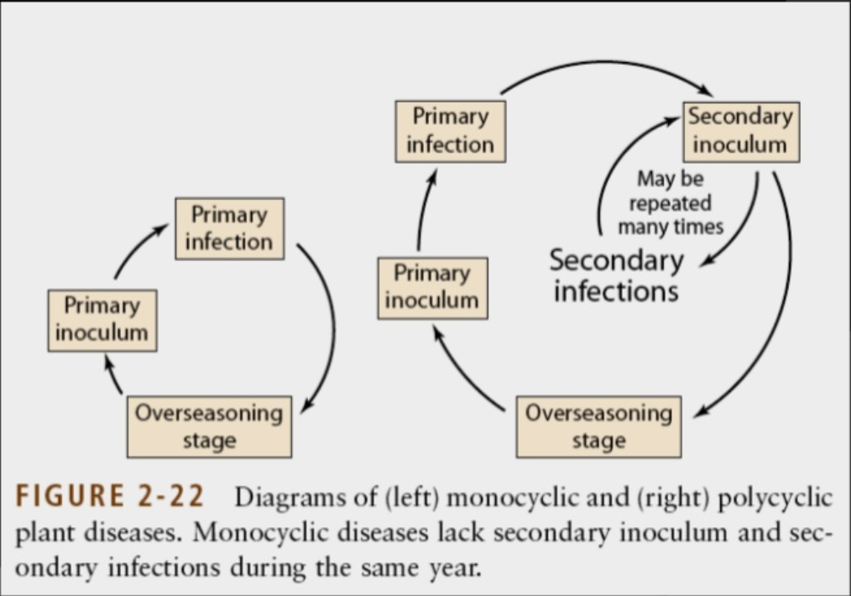
Types of Plant Diseases
Fungi
Fungus-like Organisms
Bacteria
Viruses, Viroids, Virus-like Organisms
Nematodes
Protozoa & Algae
Parasitic Plants
Infection Cycles
Monocyclic
Polycyclic
* Does not include plant-eating pests, insects, or ectoparasites.

Slide 5
Disease Forecasting Systems
Use multiple parameters to predict growth and change of plant diseases and can determine whether action must be taken to control a disease (pesticide treatment)
Stewart’s wilt first forecasting system - low winter temperature would kill disease range preventing epidemic
Assumption-based prediction on interactions (Disease Triangle) - prediction of when the pathogen, host plant, and environment interacting in a way that causes a disease

Slide 6
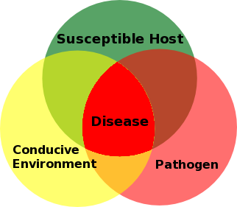
Modeling Factors: Plant Disease Triangle
Factors necessary for disease:
Susceptible Host
Pathogen
Conducive Environment
Can also include Humans & Time
* Need understanding on actual disease parameters for Forecasting System

Slide 7
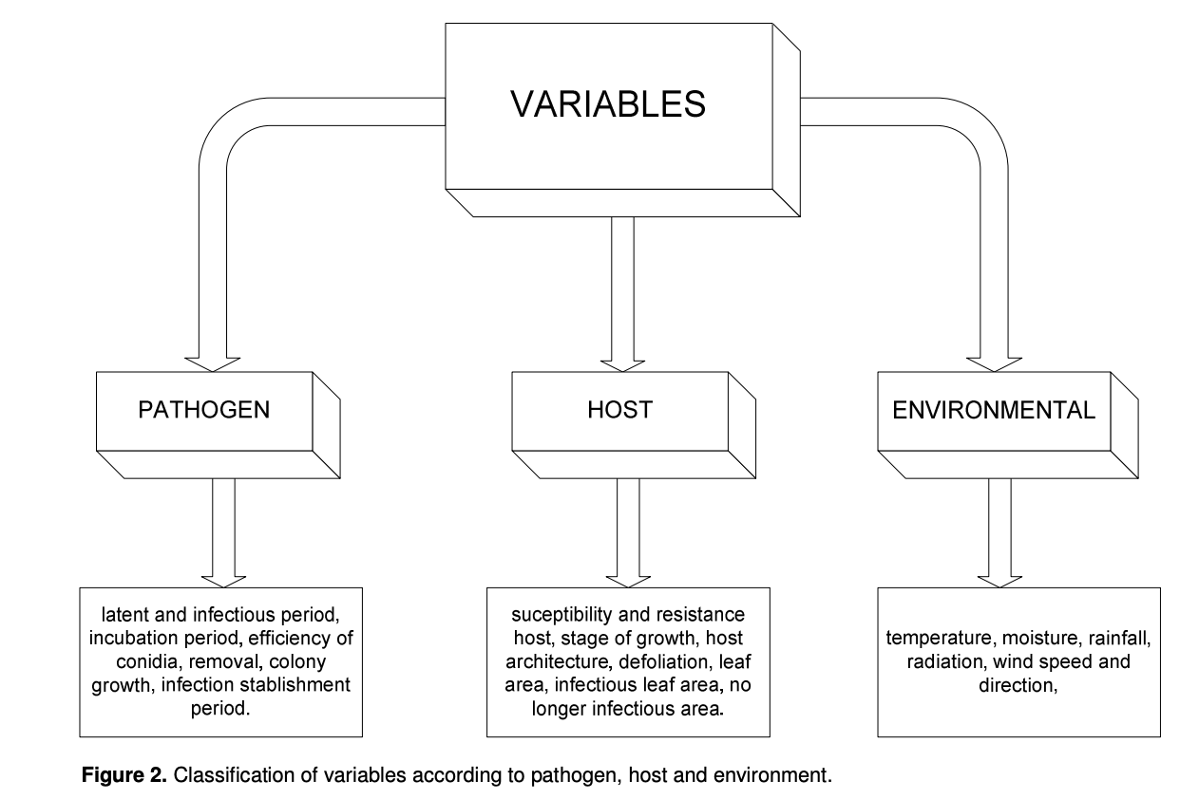

Slide 8
Disease Progress Curves
Monomolecular - used single cycle diseases
Exponential - used when one infected plant infects another
Logistics - common for epidemic description with secondary spreading
Compares effects of variables on disease development
Predict future outcome and control
Area under the Disease Progress Curve used to make comparisons between cycles and treatments

Slide 9




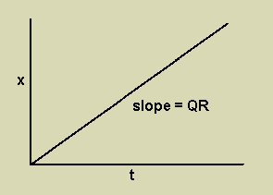
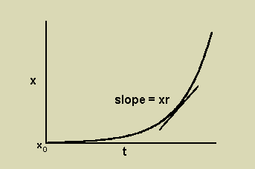
Monocyclic Polycyclic
Differential Equation:
After integration:
Differential Equation:
After integration:
x - variable measured
t - time
Q - initial inoculum
R - rate of disease progression per unit of inoculum
x - variable measured
t - time
x0 - initial proportion of disease
r - rate of disease progression per unit of inoculum

Slide 10

Computer Simulations
Large number of computer simulations exist for plant modeling.
They differ depending on the host plants, pathogens and environment.
Model to demonstrate valid/controlled interactions to gather data, possible solutions to and control of the disease.
Based on extension of LDE modeling and follows general form:

Slide 11
Importance of Plant Disease Modeling
Disease is estimated to decrease plant yield 10%-20% each year, causing farmers to face major economic losses
Modeling of Plant Diseases can help provide valuable data, disease management solutions and reliability in crop growth.

Slide 12
Sources
https://link.springer.com/article/10.1023/A:1026018005613
https://web.archive.org/web/20080411211648/http://www.apsnet.org/education/AdvancedPlantPath/Topics/RModules/Doc1/
https://en.wikipedia.org/wiki/Plant_disease_forecasting
https://en.wikipedia.org/wiki/Plant_pathology
https://web.archive.org/web/20080623093120/http://www.apsnet.org/education/AdvancedPlantPath/Topics/Epidemiology/Epidemiology.htm#modelling
https://www.slideshare.net/golamdastogeer/plant-disease-epidemiology-a-lecture-for
https://www.apsnet.org/edcenter/disimpactmngmnt/topc/EpidemiologyTemporal/Pages/Disease%20Progress.aspx
https://link.springer.com/chapter/10.1007%2F978-90-481-9277-9_15 https://www.frontiersin.org/articles/10.3389/fenvs.2018.00063/full
https://www.researchgate.net/publication/225982695_Modelling_Plant_Disease_Epidemics
https://www.apsnet.org/edcenter/disimpactmngmnt/topc/EpidemiologyTemporal/Pages/ModellingProgress.aspx
“I pledge my honor that I have abided by the Stevens Honor System.”

Slide 13
Final Presentation

Slide 14
Xylem cavitation susceptibility and refilling mechanisms in olive trees infected by Xylella fastidiosa
Sabella, Erika et al. “Xylem cavitation susceptibility and refilling mechanisms in olive trees infected by Xylella fastidiosa.” Scientific reports vol. 9,1 9602. 3 Jul. 2019, doi:10.1038/s41598-019-46092-0

Slide 15
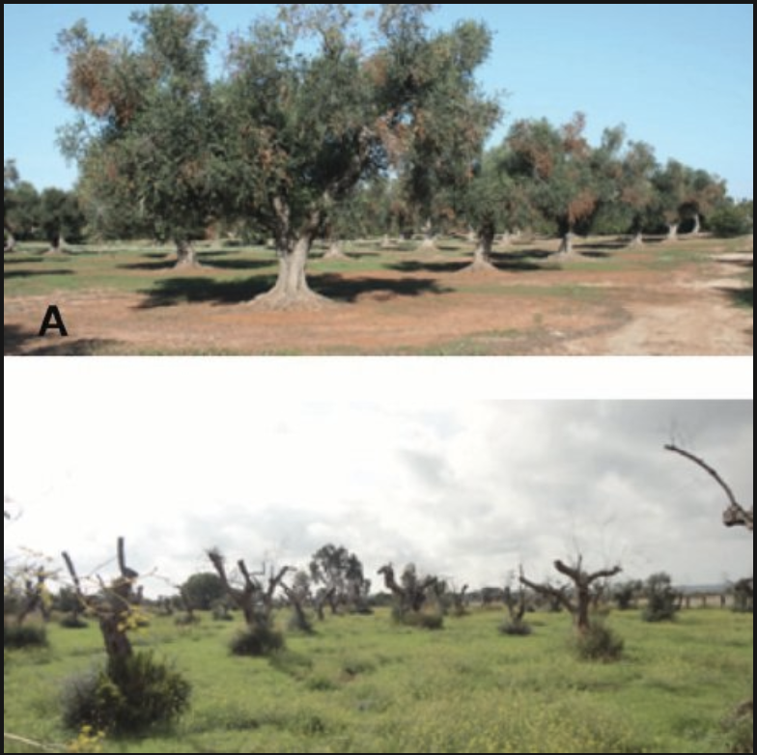
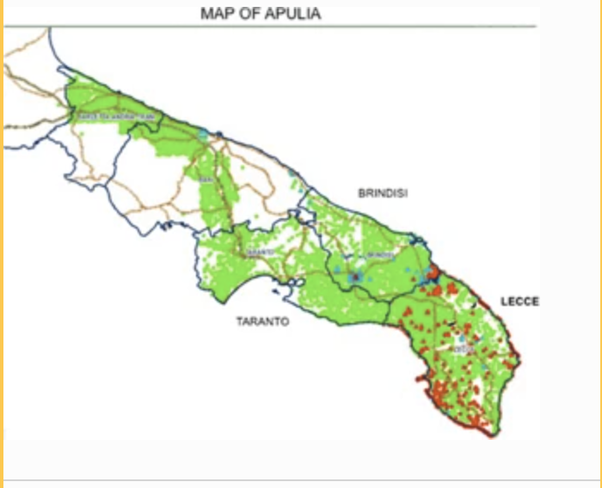
Plant Disease Triangle
Pathogen:
Bacterium Xylella fastidiosa
Olive quick decline syndrome (OQDS)
Host Plant:
Olive Trees - specifically local cultivars
‘Cellina di Nardò’ & ‘Ogliarola salentina’
Conducive Environment:
Ionian coast of the Salento peninsula
(Apulia, southern Italy)
Notes:
SPEAKER NOTES TO SAY
In autumn 2013, the presence of Xylella fastidiosa, a xylem-limited Gram-negative bacterium, was detected in olive stands of an area of the Ionian coast of the Salento peninsula (Apulia, southern Italy), that were severely affected by a disease denoted olive quick decline syndrome (OQDS).
but the disease incidence increased rapidly through the heavily olive-grown countryside of the peninsula
The highly susceptible local cultivars ‘Cellina di Nardò’ and ‘Ogliarola salentina’ are the most severely affected. These symptomatic trees are subjected to heavy pruning to stimulate new growth, but the new vegetation soon withers and desiccates”
the wide distribution of olive orchards in Apulia and the abundance of a bacterial vector (Philaenus spumarius L.) populations10 are the factors that contribute the most to the entrenchment of X. fastidiosa in the territory and to the emergence of the associated disease. This alarming scenario is further aggravated by the favourable conditions for bacterial growth and host colonization occurring in the coastal areas of the Mediterranean, which are characterized by a temperate climate with mild winters1

Slide 16
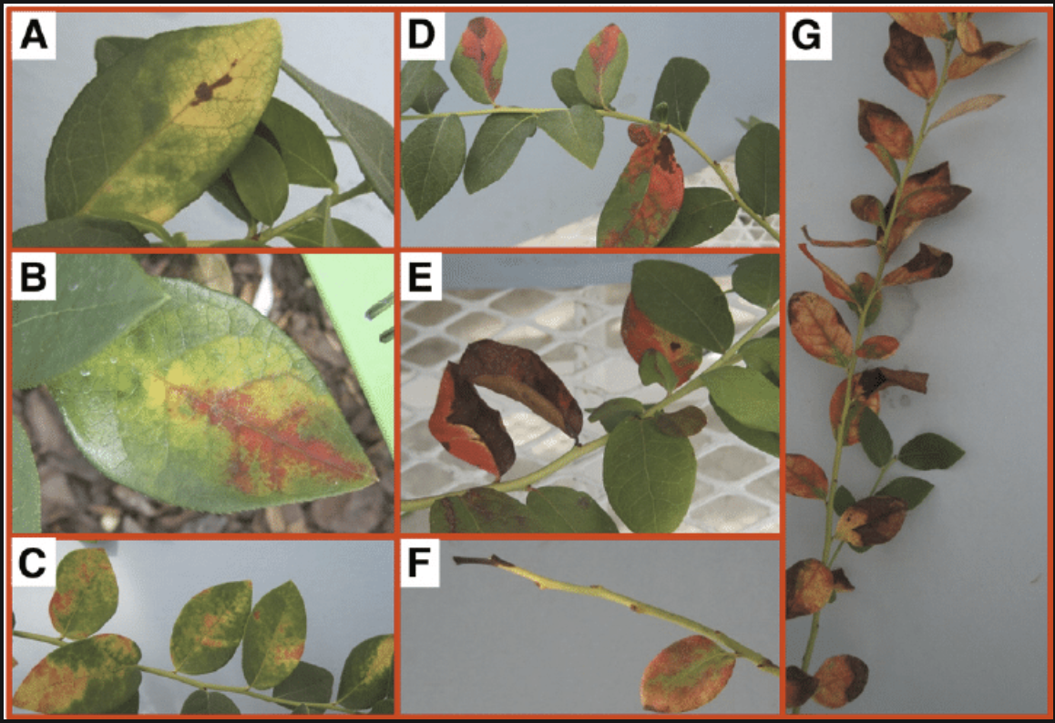
Xylella fastidiosa
Xylem-limited Gram-negative bacterium
colonizes xylem vessels
Transmits to new host plant by insects sap feeding
Spreads xylem vessels from infection site
Embolism triggered
Bacterium X. fastidiosa biofilm contribute to the vascular obstruction
The plants’ responses that could trigger embolism.
ability to detect and to respond can influence the severity
Often identified with ‘scorch leaf’ (seen right)
In olive trees, it compromises water transport determining a decrease in stem-specific hydraulic conductivity, causing olive quick decline syndrome (OQDS)
Notes:
Xylem-limited Gram-negative bacterium
colonizes xylem vessels (The xylem are vessels and tracheids of the roots, stems and leaves forming a system of water-conducting channels transporting water and nutrients from the roots throughout the plant)
transmitted to new host plants during sap feeding by insect vectors
spreads from the site of infection to the plant’s network of xylem vessels
The loss of hydraulic conductivity could be attributed to vessel occlusions induced both by the bacteria biofilm and by plant responses (tyloses, gums, etc.) that could trigger embolism. The ability of the infected plants to detect embolism and to respond, by activating mechanisms to restore the hydraulic conductivity, can influence the severity of the disease symptomatology.
X. fastidiosa biofilms contribute to the vascular obstruction. In olive trees it compromises water transport causing the olive quick decline syndrome (OQDS).
This loss of xylem water-transporting function determines a decrease in stem-specific hydraulic conductivity.

Slide 17
Hypothesis
Investigation of X. fastidiosa
resistant olive cultivar Leccino
susceptible Cellina di Nardò
Analysis of healthy olive stems
laser scanning microscope
calculate the cavitation vulnerability index
Leccino constitutively less susceptible to cavitation
SEM-EDX analysis of infected plants => starch grains in the Leccino xylem vessels
Hypothesis:
The cultivar Leccino, not only anatomically less susceptible to cavitation
Possibly able to activate more efficient refilling mechanisms and restore the vessel’s hydraulic conductivity
Notes:
In order to investigate these mechanisms in the X. fastidiosa-resistant olive cultivar Leccino and in the susceptible Cellina di Nardò, sections of healthy olive stems were analysed by laser scanning microscope to calculate the cavitation vulnerability index.
Findings indicated that the cultivar Leccino seems to be constitutively less susceptible to cavitation than the susceptible one. Among the vascular refilling mechanisms, starch hydrolysis is a well-known strategy to refill xylem vessels that suffered cavitation and it is characterized by a dense accumulation of starch grains in the xylem parenchima; SEM-EDX analysis of stem cross-sections of infected plants revealed an aggregation of starch grains in the Leccino xylem vessels
. These observations could indicate that this cultivar, as well as being anatomically less susceptible to cavitation, it also could be able to activate more efficient refilling mechanisms, restoring vessel’s hydraulic conductivity.

Slide 18
Xylem vessel diameter and vulnerability to cavitation in stem of Leccino and Cellina di Nardò
VI=VD/VF
Vulnerability to cavitation (vulnerability index, VI) was calculated using the equation proposed by Carlquist.
VF is vessel frequency (number of vessels per mm2, N/mm2), while VD is the mean vessel diameter (µm).
Use the Student’s t-test to determine the statistical differences between the quantitative continuous data of xylem vessel diameters and the plants vulnerability to cavitation.
Dividing the difference in means by the variance in data.
The Student t-test was used to test the statistical significance of the differences found in the vessel density for different classes of cultivars.
The Student’s T-test was performed shows that there is a statistically significant difference between groups of Cellina di Nardo and Leccino involving the Anatomical Characters (vessel density) and Vulnerability index (VI).
It shows that vessels frequency was lower in the stem of the cultivar Cellina di Nardò making it more vulnerable at a statistical significance of P<0.001

Slide 19
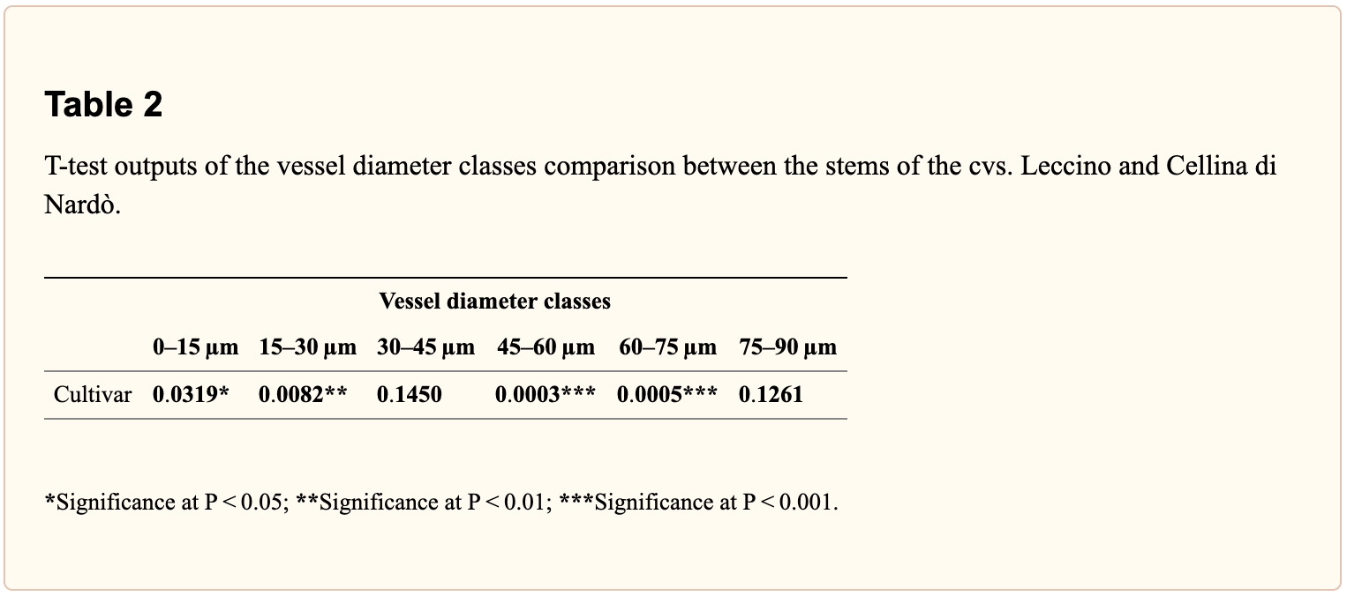
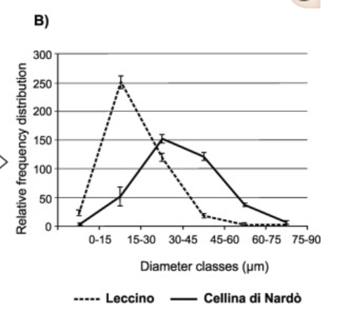
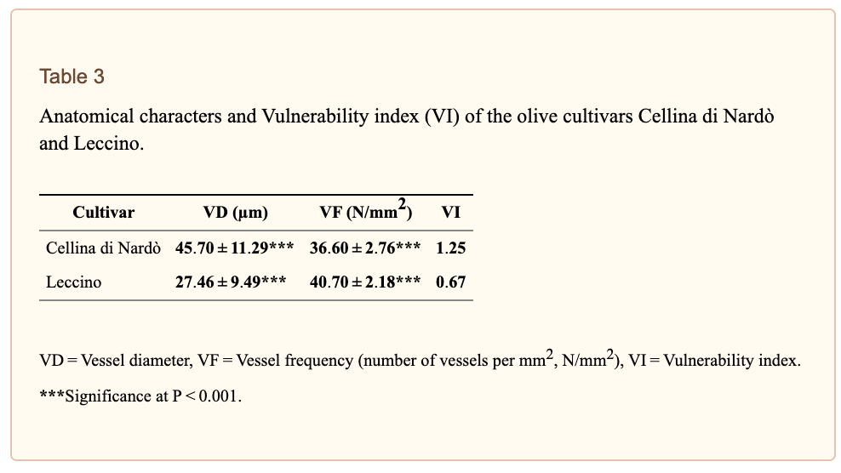
Leccino cultivar is characterized by a tighter and more homogeneous vessel apparatus if compared to Cellina di Nardò ones
Notes:
Table 2 - is comparing diameter classes between the two stems - this test shows the statistical significance between number of species of plants per vessel diameter class
Table 3 - the vi is a numerical value appointed to groups based on the number of vessels per milimeter squared divided by the average vessel diameter
This shows that the di nardo had a higer vulnerability index of 1.25 versus the leccino of 0.67, showing a greater predicted risk of vulnerability to embolisms. The numbers for each group that led tho these indexes (VD and VF for both cultivars) were statistically significant at a value of P<0.001
Meaning theres a statistical weight on this index
Chart - This chart demonstrates the distribution between categories of diameter classes (of vessel size) for both groups, cultivar Leccino and Cellina di Nardo. This shows that the Leccino was more narrowly distributed between the lower diameter classes, averaging a peak at about the 15-30 class, and sharply declining after the class 30-45. The Cellina di Nardo was more widely distributed, having two average peaks before and after the 30-45 nanometers group, with no sharp decline in distribution like the Leccino group. The Leccino group also proved higher frequency of this lower diameter, meaning much more plants were within that diameter group.

Slide 20
Findings
Symptoms development is correlated with a decrease of xylem water-transporting that could cause embolism
Leccino
Cellina di Nardò
The measurement of an anatomical feature, the xylem vessels diameter, in two Olea europaea cultivars provide an indication of susceptibility/resistance to Xylella fastidiosa
“The differences in cavitation susceptibility determined by the constitutive anatomy of the xylem and a major capacity to active refilling mechanisms after embolism sensing could be involved in the specific cultivar response to the pathogen”

Slide 21
Why was this important?
Notes:
“Plant diseases caused by bacterial pathogens place major constraints on crop production and cause significant annual losses on a global scale.”
“The ever‐increasing global human population requires the continued stable production of a safe food supply with greater yields because of the shrinking areas of arable land. “
maintenance of the sustainability of crop production systems with predictable yields involves the identification and deployment of sustainable disease management solutions for bacterial diseases.

Slide 22
Sources
https://www.ncbi.nlm.nih.gov/pmc/articles/PMC6610111/
https://link.springer.com/article/10.1023/A:1026018005613
https://web.archive.org/web/20080411211648/http://www.apsnet.org/education/AdvancedPlantPath/Topics/RModules/Doc1/
https://en.wikipedia.org/wiki/Plant_disease_forecasting
https://en.wikipedia.org/wiki/Plant_pathology
https://web.archive.org/web/20080623093120/http://www.apsnet.org/education/AdvancedPlantPath/Topics/Epidemiology/Epidemiology.htm#modelling
https://www.slideshare.net/golamdastogeer/plant-disease-epidemiology-a-lecture-for
https://www.apsnet.org/edcenter/disimpactmngmnt/topc/EpidemiologyTemporal/Pages/Disease%20Progress.aspx
https://link.springer.com/chapter/10.1007%2F978-90-481-9277-9_15 https://www.frontiersin.org/articles/10.3389/fenvs.2018.00063/full
https://www.researchgate.net/publication/225982695_Modelling_Plant_Disease_Epidemics
https://www.apsnet.org/edcenter/disimpactmngmnt/topc/EpidemiologyTemporal/Pages/ModellingProgress.aspx
“I pledge my honor that I have abided by the Stevens Honor System.”

